Slide 1

Africa: Some Background

Slide 2
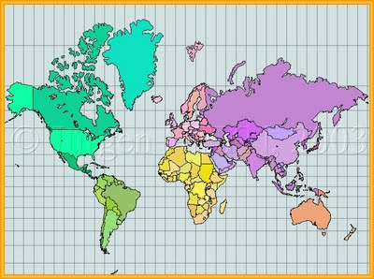
Mercator Projection (1569)

Slide 3
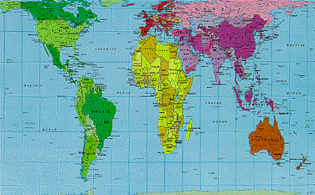
Peters Projection (1974)
West Wing video clip

Slide 4
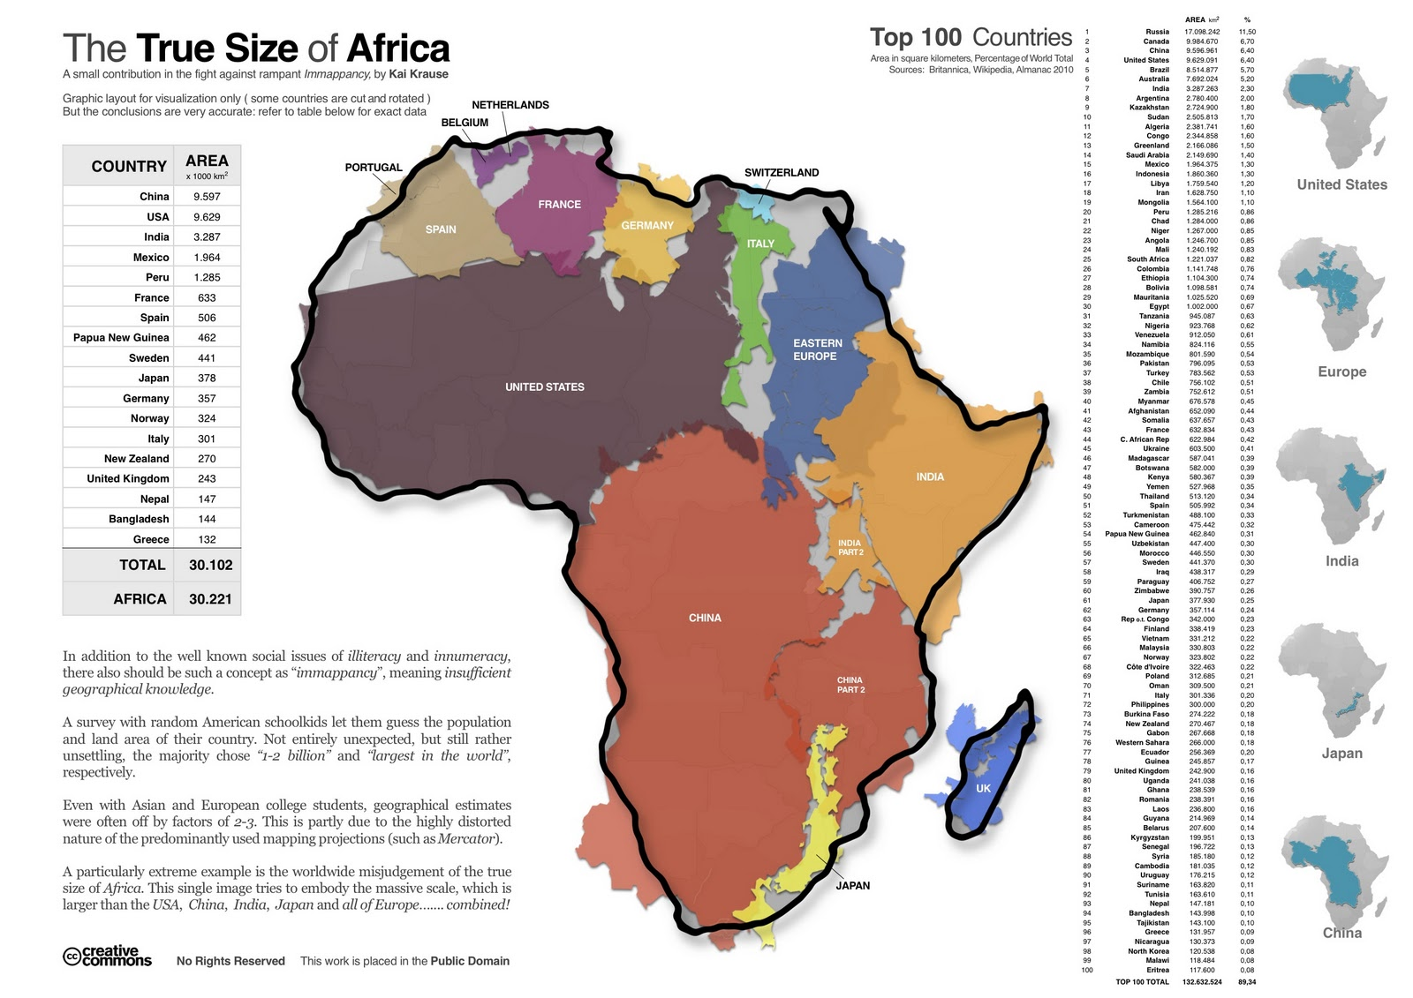

Slide 5
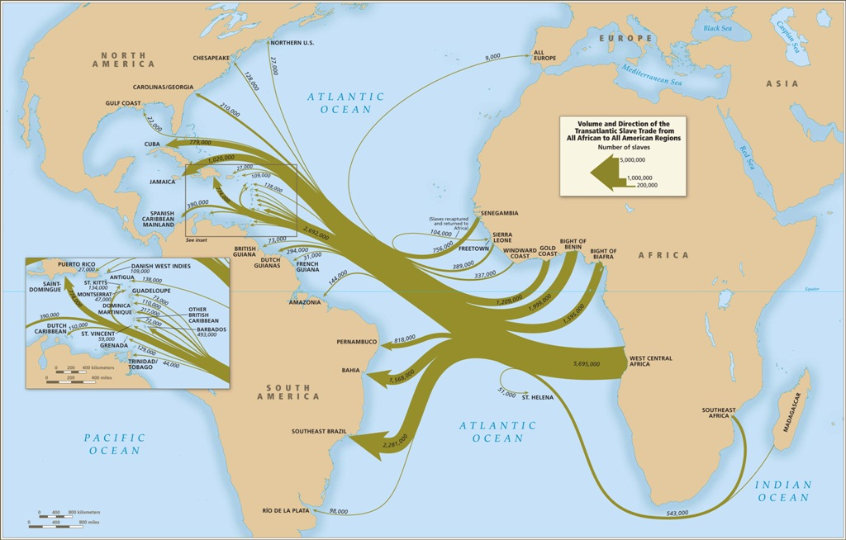
So Called “Slave Trade”

Slide 6
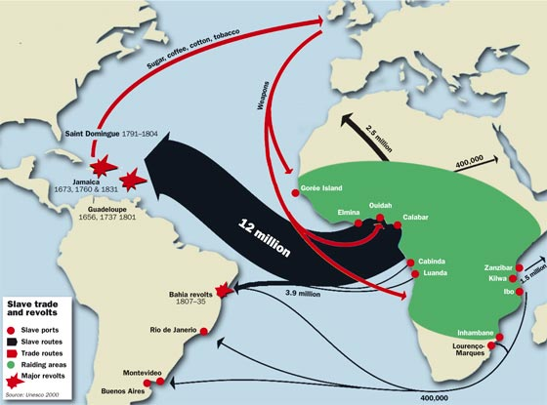
Slave Warfare

Slide 7
Continental Population Statistics (in millions)
 | 1650 | 1750 | 1850 | 1900
Africa | 100 | 100 | 100 | 120
Europe | 103 | 144 | 274 | 423
Asia | 257 | 437 | 656 | 857
Source: How Europe Underdeveloped Africa

Slide 8
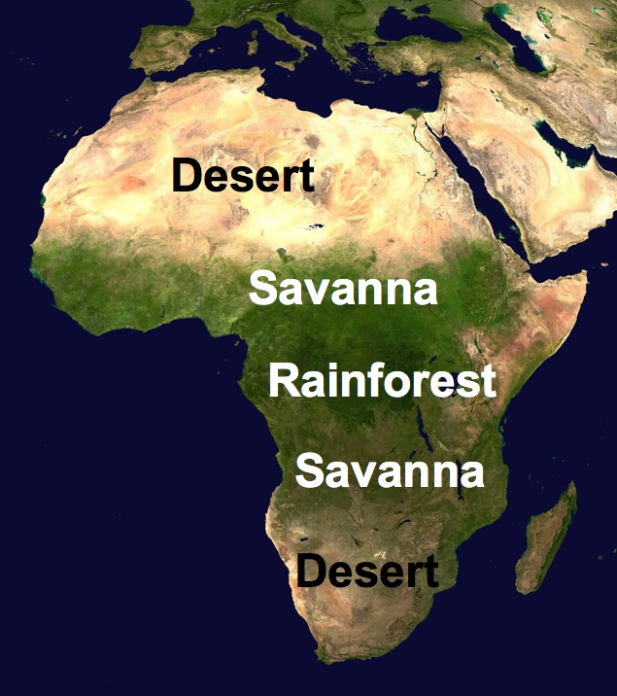

Slide 9
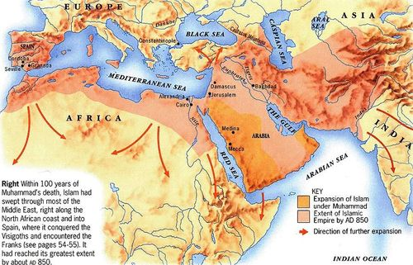
Muslim Conquests

Slide 10
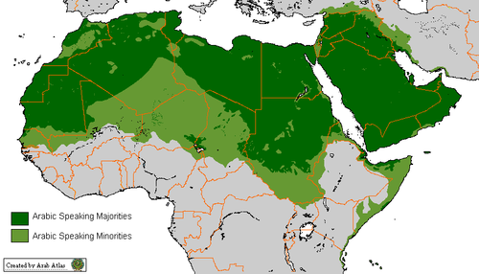
Arab Speaking Areas Today

Slide 11
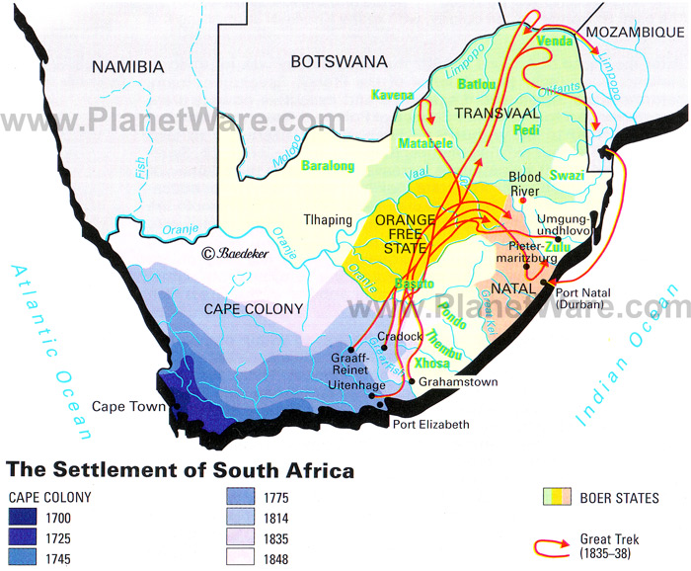

Slide 12
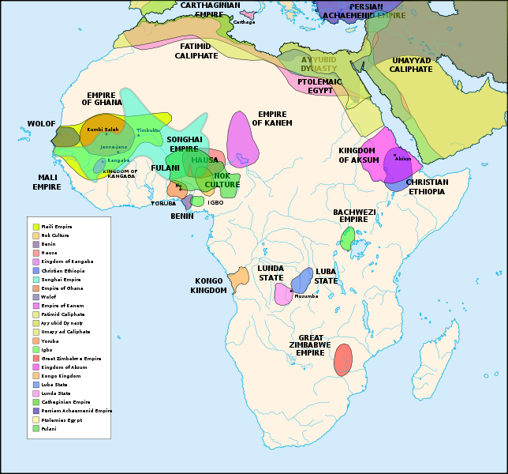
African Precolonial States

Slide 13
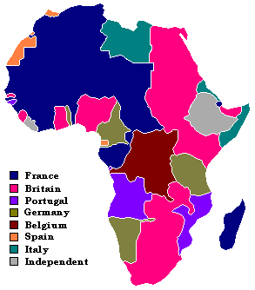
Scramble for Africa Berlin Conference 1884, Map 1914

Slide 14
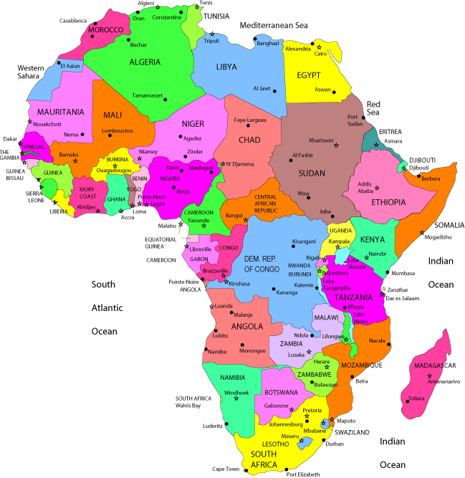
Postcolonial African States

Slide 15
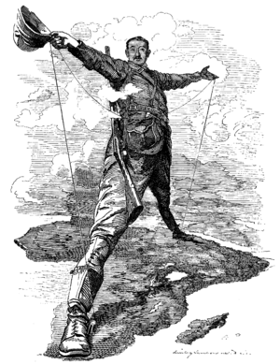
British Africa: Cape to Cairo

Slide 16
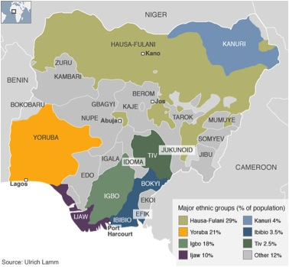
Nigerian Ethnic Groups

Slide 17
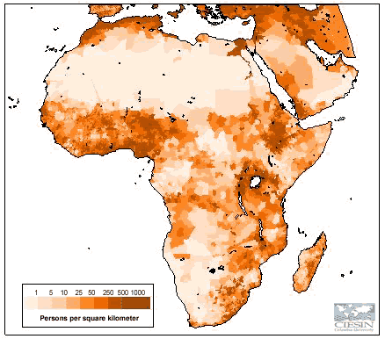
Population Density

Slide 18
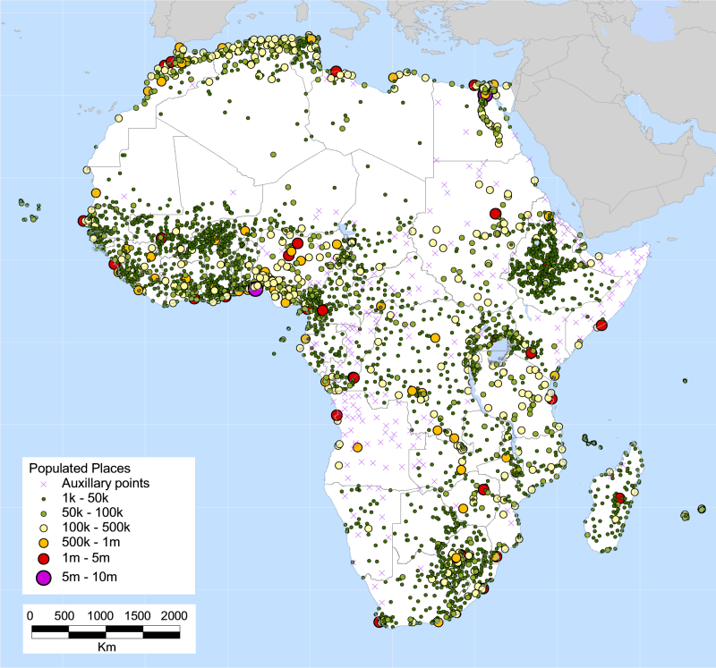

Slide 19
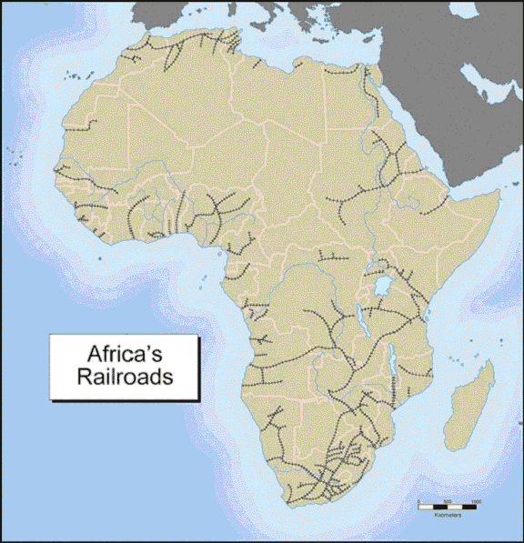
African Railroads

Slide 20


Slide 21
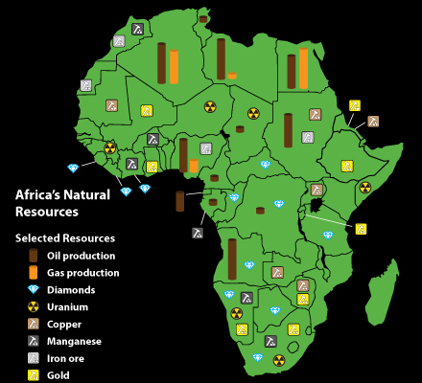

Slide 22
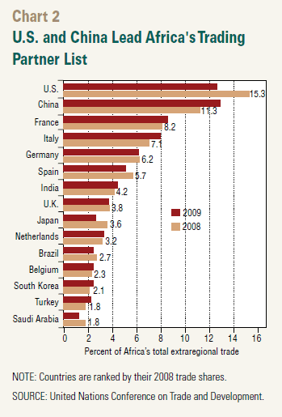

Slide 23
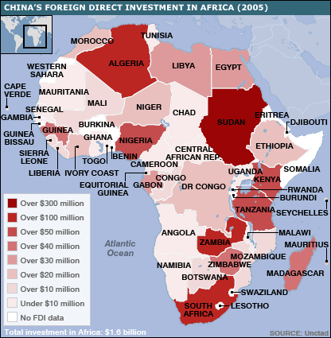

Slide 24
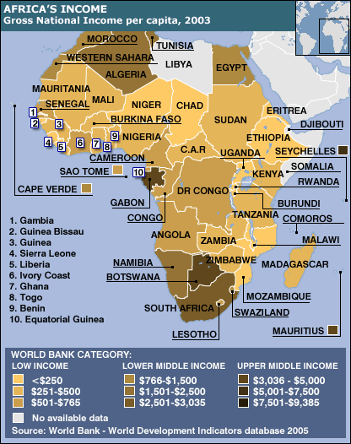

Slide 25
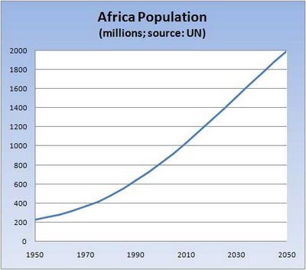

Slide 26
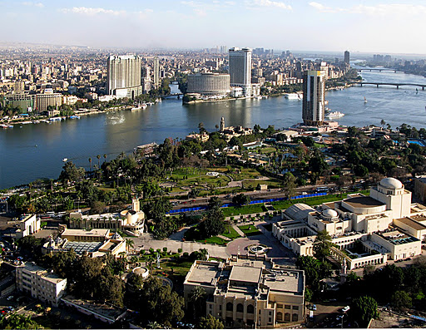
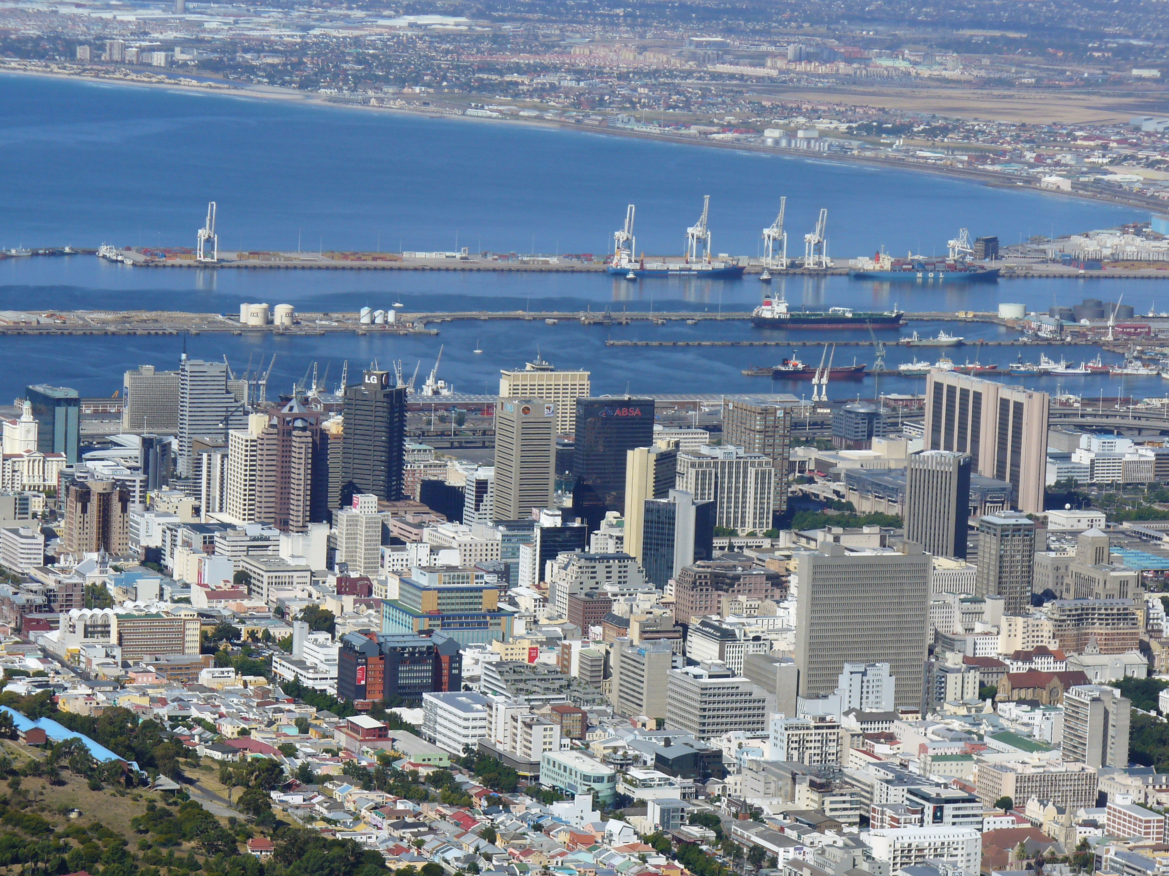
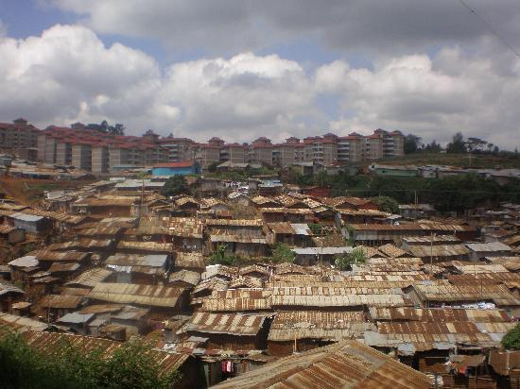
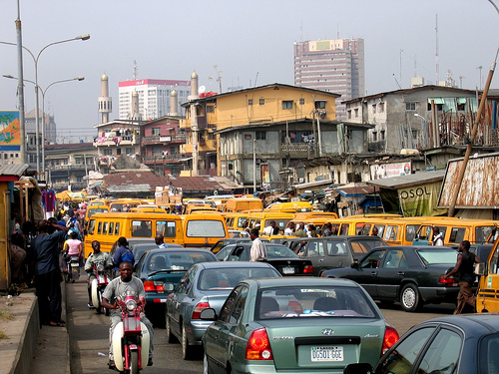
African Cities

Slide 27
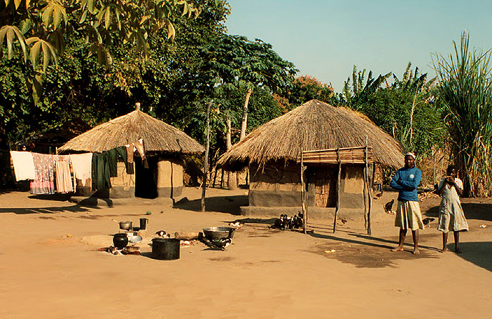
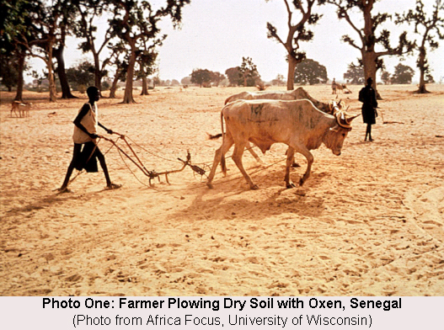

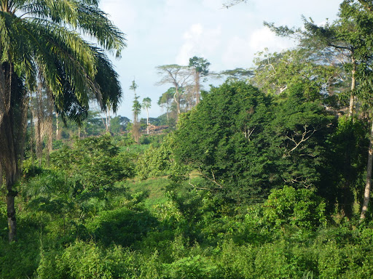
Rural Africa

Slide 28
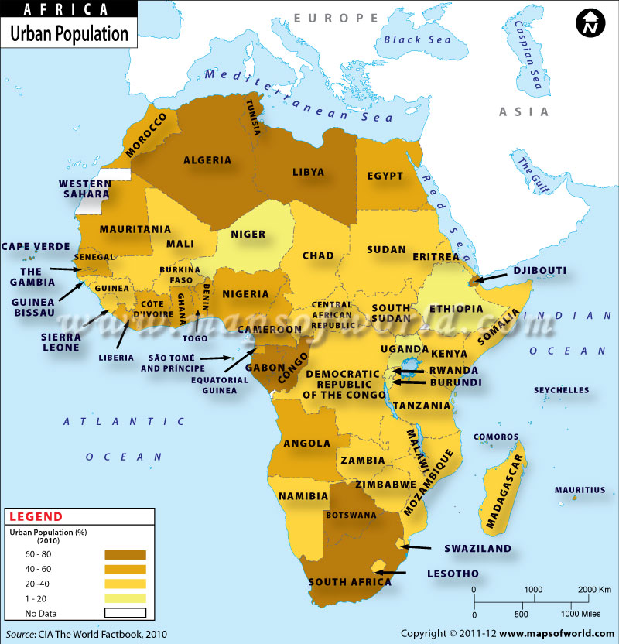

Slide 29
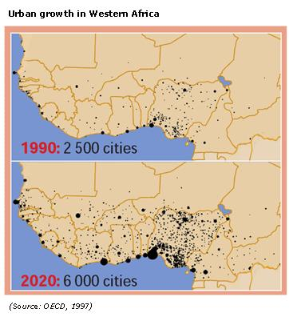

Slide 30
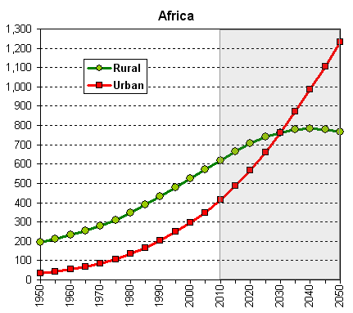

Slide 31
Land Grabs
“Land grabs displace subsistence farmers and farming communities, making it necessary for inhabitants to seek opportunities elsewhere. The amount of African land sold annually to multi-national corporations has increased from 10 million acres to about 110 million acres between 2008 and early 2010- the size of California and West Virginia combined. Over 70% of these land deals are concentrated in Mali, Libya, Sudan, Ethiopia, Madagascar and Mozambique. The rise in land deals in Africa is partly due to the global food crisis.” (Sojourner Project)

